Slide 1







Statistical Approaches, Made Simple
SESSION 5 · THEORY (SIMPLIFIED)
SESSION
5
Seven topics · ten slides each · everyday examples
Theory 2 h · Lab 4 h · Self-learning 1 h
Notes:
A simplified version of the Session 5 theory: the same seven topics, explained with everyday analogies and one tiny dataset of eight theme-park reviews that students can count by hand. Reference text: Bhattacharyya & Joshi, Natural Language Processing (Wiley India, 2023): §1.3, §3.2, §4.4, Ch. 8. Examples marked 'illustrative' use invented numbers; 'real' results were computed on NLTK corpora.

Slide 2
What we will learn, in plain words
OVERVIEW
1
Probability How likely is something? Count and divide.
2
Discrete-time models Text is a chain of words; each word depends on the last one.
3
Markov and entropy models Predict the next word; guess hidden labels; measure surprise.
4
Statistical parsing Many possible sentence structures: pick the most likely one.
5
Classification and clustering Sort texts into labelled boxes, or find natural groups.
6
Support vector machines Draw the widest possible street between two groups.
7
Centroid classification Compare a new text with the ‘average’ text of each group.
Notes:
Each topic: a section divider and ten slides.

Slide 3
Our mini dataset: eight theme-park reviews
OVERVIEW
We will use these eight tiny reviews again and again. Every number can be counted by hand.
# | REVIEW | LABEL
1 | the park was fun | pos
2 | the rides were fun | pos
3 | the food was great | pos
4 | the staff were kind | pos
5 | the queue was long | neg
6 | the food was cold | neg
7 | the staff were rude | neg
8 | the rides were closed | neg
32 words in total
8 reviews × 4 words.
15 different words
the, was, were, fun, rides, food, staff, park, great, kind, queue, long, cold, rude, closed.
Two labels
4 positive (pos) and 4 negative (neg).
Why so small?
So that every count, probability and decision on the slides can be checked with pencil and paper. Real-data results follow each idea.
Notes:
Invented reviews, designed to be countable. Real-corpus results appear on later slides marked 'real'.

Slide 4

Probability
1
How likely is something? Count and divide.

Slide 5
What is probability?
1 · PROBABILITY
A number from 0 to 1 that says how likely something is.
0
0.25
0.5
0.75
1
impossible
the sun rises in the west
unlikely
a review starts with “queue”
even chance
a coin lands heads
likely
it rains in Mumbai in July
certain
a review in our dataset starts with “the”
Why NLP needs it
language is full of guesses: which word comes next? Is this review happy or angry? Is “book” a noun or a verb?
The basic rule
probability = how many times it happened ÷ how many chances there were.
Notes:
“the” starts all 8 of our reviews: 8/8 = 1. “queue” starts none: 0/8. The 0.25 and 0.75 examples are everyday illustrations.

Slide 6
Probability = count ÷ total
1 · PROBABILITY
Put all 32 words of our reviews in a bag. Pull one out without looking.
P(the)
8 ÷ 32 = 0.25
P(fun)
2 ÷ 32 = 0.06
P(rude)
1 ÷ 32 = 0.03
P(magic)
0 ÷ 32 = 0
A word we never saw gets 0. Remember this problem: we fix it in Topic 3.
Notes:
This 'count and divide' estimate is called the maximum-likelihood estimate (MLE).

Slide 7
Your phone keyboard is doing probability
1 · PROBABILITY
Autocomplete suggests the words that most often came next in text it has seen.
I am going to the ▌
Same idea everywhere
spelling correction, speech-to-text, translation, search suggestions and chatbots all rank possible answers by probability.
market
office
station
In our reviews
after “the”, the next word is rides, food or staff (2/8 each), park or queue (1/8 each).
P = 0.30
P = 0.22
P = 0.15
Illustrative probabilities.
Big idea
we don't need rules for every case: counting enough text gives good guesses.
Notes:
The 'after the' counts are from the toy dataset.

Slide 8
Two things at once: a joint count table
1 · PROBABILITY
Count reviews by two questions at once: does it contain “fun”? Is it positive?
 | CONTAINS “fun” | NO “fun” | TOTAL
positive | 2 | 2 | 4
negative | 0 | 4 | 4
total | 2 | 6 | 8
Joint: both together
P(positive AND “fun”) = 2 ÷ 8 = 0.25
One at a time
P(positive) = 4 ÷ 8 = 0.5 P(“fun”) = 2 ÷ 8 = 0.25
Not
P(not positive) = 1 − 0.5 = 0.5
Real data shows the same pattern. In the Brown corpus, 36 of the 40 uses of “love” are in romance stories, and 90 of 149 uses of “tax” are in government documents.
Notes:
Brown counts are real (news + romance + government genres).

Slide 9
“Given that…”: conditional probability
1 · PROBABILITY
Conditional probability = look only at the cases where something is already true.
the park was fun
The other direction
P(“fun” | positive) = 2 ÷ 4 = 0.5: half of the positive reviews say “fun”.
← the only reviews with “fun”
the rides were fun
They are different!
“Every review with ‘fun’ is positive” is not the same as “every positive review says ‘fun’”.
P(positive | “fun”) = 2 ÷ 2 = 1.0
read “|” as “given”
Formula
P(A | B) = P(A and B) ÷ P(B) = 0.25 ÷ 0.25 = 1.0
This is what a classifier asks. “I see these words; given that, which label is most likely?”
Notes:
All numbers from the toy dataset.

Slide 10
Do two things affect each other? Independence
1 · PROBABILITY
Two things are independent if knowing one tells you nothing about the other.
Independent: two coin flips
The first flip landing heads does not change the second flip: still 0.5.
P(heads, heads) = 0.5 × 0.5 = 0.25
Not independent: words and topics
Real Brown corpus: “she” is 3.3 words per 1,000 overall, but 10.4 per 1,000 in romance stories. Knowing the genre changes the chance.
Test
if P(A | B) = P(A), then A and B are independent.
In our reviews
P(“fun”) = 2/8 = 0.25 but P(“fun” | positive) = 2/4 = 0.5: “fun” depends on the label. That is exactly why words help classify.
A useful simplification
Naive Bayes (Topic 5) pretends words are independent of each other. Not true, but it makes counting easy and works well.
Notes:
Brown figures real (news + romance + government). Toy figures from the dataset.

Slide 11
The probability of a sentence: multiply step by step
1 · PROBABILITY
Chain rule: P(sentence) = P(first word) × P(next | previous) × P(next | previous) × …
the
food
was
fun
Notice
“the food was fun” never appears in our reviews, yet it gets a sensible probability, because each step was seen.
P(the starts a review)
8 / 8
1
Each step uses only the previous word
a simplification called the Markov assumption (Topic 2).
P(food | the)
2 / 8
0.25
P(was | food)
2 / 2
1
P(fun | was)
1 / 4
0.25
Comparison
“the park was long” = 1 × 1/8 × 1 × 1/4 = 0.031: half as likely.
P(“the food was fun”) = 1 × 0.25 × 1 × 0.25 = 0.0625
Notes:
Counts from the toy dataset. 'the' is followed by food in 2 of 8 cases; 'food' is always followed by 'was' (2/2); 'was' is followed by fun, great, long, cold (1/4 each).

Slide 12
Bayes' rule: a spam filter in one table
1 · PROBABILITY
Turn “how often spam contains ‘free’” into “how likely an email with ‘free’ is spam”.
100 EMAILS | CONTAINS “free” | NO “free” | TOTAL
spam | 16 | 4 | 20
not spam | 4 | 76 | 80
total | 20 | 80 | 100
Easy to count
P(“free” | spam) = 16 ÷ 20 = 0.8
What we want
P(spam | “free”) = 16 ÷ 20 = 0.8: of the 20 emails with “free”, 16 are spam.
Illustrative numbers.
Before vs after
before reading: 20% of emails are spam. After seeing “free”: 80%.
Bayes' rule in words. P(spam | word) = P(word | spam) × P(spam) ÷ P(word) = 0.8 × 0.2 ÷ 0.2 = 0.8. Naive Bayes classifiers (Topic 5) use exactly this.
Notes:
Illustrative counts chosen so both routes give 0.8. Emphasise that P(free | spam) = 0.8 and P(spam | free) = 0.8 are equal here only by coincidence of the chosen counts.

Slide 13
A few words are everywhere; most words are rare
1 · PROBABILITY
In real text, a handful of words make up half of everything (Zipf's law).
49%
of all words are one of just 100 common words
38%
of different words appear only once in a million words
1 ÷ rank
the 2nd word is about half as common as the 1st, the 3rd a third…
Notes:
Real: Brown corpus, 981,716 lower-cased alphabetic tokens, 40,234 different words.

Slide 14
Two kinds of probability models
1 · PROBABILITY
A writer who knows how each type of review is written, or a judge who just decides.
The writer (generative)
Learns how positive and negative reviews are usually written, then asks: “which writer would most likely have produced this review?”
Examples: Naive Bayes, hidden Markov models, probabilistic grammars.
The judge (discriminative)
Never learns to write. Learns directly which clues point to which label, and weighs them.
Examples: logistic regression, support vector machines.
Spelling correction as a ‘writer’ model. You typed “teh”. Which intended word most likely turned into “teh”? “the”: it is very common, and swapping two letters is a common typo.
Notes:
The spelling example is the noisy-channel model: P(intended word) × P(typo | intended word).

Slide 15

Discrete-time models
2
Text is a chain of words: each step depends on the last.

Slide 16
Text is a sequence, one step at a time
2 · DISCRETE-TIME MODELS
Read a sentence like beads on a string: step 1, step 2, step 3…
step 1
step 2
step 3
step 4
the
food
was
fun
Discrete
we move in whole steps (word 1, word 2), not smoothly like a clock's second hand.
The key question
how much does the next word depend on the words before it?
Other sequences
letters in a word, POS tags in a sentence, turns in a conversation, sounds in speech.
Notes:
Formally: a discrete-time stochastic process X1, X2, … with values in a finite set (the vocabulary).

Slide 17

The goldfish rule: remember only the last step
2 · DISCRETE-TIME MODELS
A Markov model has a short memory: the next word depends only on the current word.
Why forget the rest?
remembering everything needs far more data: most long word sequences are never repeated.
Like a goldfish that only remembers the last thing it saw.
Longer memory
remember 2 words (trigram), 3 words … More accurate, but needs much more text.
the
staff
were
▢
To guess ▢, look only at “were”.
After “were”: fun, kind, rude, closed (1/4 each).
Good enough
short memory already captures a lot: “very” → much, “Miss” → Woodhouse.
Notes:
The 'were' counts are from the toy dataset; 'very → much' and 'Miss → Woodhouse' are real bigrams from Emma.

Slide 18
A Markov chain you already know: the weather
2 · DISCRETE-TIME MODELS
Tomorrow's weather depends (mostly) on today's.
States
the possible situations: Sunny, Rainy.
stays sunny 0.8
stays rainy 0.6
Sunny
0.2
Rainy
Transition probabilities
the chance of moving from one state to another. Each row adds up to 1.
0.4
TODAY \ TOMORROW | Sunny | Rainy
Sunny | 0.8 | 0.2
Rainy | 0.4 | 0.6
Example
today Sunny. P(Sunny tomorrow, then Rainy) = 0.8 × 0.2 = 0.16
Notes:
Illustrative weather probabilities. Replace weather with words and you have a language model.

Slide 19
Looking two steps ahead
2 · DISCRETE-TIME MODELS
Today is Sunny. What is the chance it is Sunny the day after tomorrow?
Sunny → Sunny → Sunny
0.8 × 0.8
= 0.64
Add up all the paths
that end where you want; multiply along each path.
Sunny → Rainy → Sunny
0.2 × 0.4
= 0.08
Long run
keep going and the chance settles: this chain is Sunny two-thirds of the time, whatever today is.
Sunny in two days = 0.64 + 0.08 = 0.72
Real tags
a tag chain's long-run shares match real tag frequencies closely (NOUN 28% predicted vs 29% actual).
Notes:
Illustrative weather chain. Stationary distribution: Sunny 2/3, Rainy 1/3 (solve p = 0.8p + 0.4(1 − p)). Real tag figures from the Penn Treebank sample.

Slide 20
Now with words: what comes after “the”?
2 · DISCRETE-TIME MODELS
Count what follows each word in our reviews. That is the word's transition list.
rides
2/8
Thicker arrow = more likely
rides, food, staff: 2/8 = 0.25 each. park, queue: 1/8 = 0.125 each.
food
2/8
the
staff
2/8
Adds up to 1
2 + 2 + 2 + 1 + 1 = 8, so 8/8.
park
1/8
Missing arrows
“the” is never followed by “fun” in our data, so P(fun | the) = 0.
queue
1/8
Notes:
Counts from the toy dataset.

Slide 21
The full transition table for our reviews
2 · DISCRETE-TIME MODELS
Each row is one word; the row shows where you can go next and how likely it is.
FROM \ TO | rides | food | staff | park | queue | was | were | fun | great / long / cold | kind / rude / closed
the | 2/8 | 2/8 | 2/8 | 1/8 | 1/8
food, park, queue |  |  |  |  |  | 1
rides, staff |  |  |  |  |  |  | 1
was |  |  |  |  |  |  |  | 1/4 | 1/4 each
were |  |  |  |  |  |  |  | 1/4 |  | 1/4 each
Reading it
after “food” always comes “was” (2 out of 2: probability 1). After “was” come fun, great, long or cold, each 1 time in 4.
The table is the model
learning a Markov chain = counting pairs of neighbouring words and dividing by row totals.
Notes:
food → was (2/2), park → was (1/1), queue → was (1/1); rides → were (2/2), staff → were (2/2).

Slide 22
Walking the chain: making new sentences
2 · DISCRETE-TIME MODELS
Start at “the”, then roll a dice using each row's probabilities to choose the next word.
the
1 of 5 choices → food
OTHER SENTENCES THE CHAIN CAN MAKE
“the staff were fun”
food
always → was
“the queue was great”
was
1 of 4 → fun
“the rides were kind (odd!)”
Every pair of neighbouring words is fine; the whole sentence may not make sense. The chain only remembers one word.
Result: “the food was fun”
A new review that was never in our data!
Real version. On a whole novel (Emma) the same method writes: “emma could imagine the recurrence of the world can afford it answered mr martin …”
Notes:
The Emma sentence is real output of a bigram model (Session 5 lab, Part 2).

Slide 23
How likely is a sentence? Follow the arrows and multiply
2 · DISCRETE-TIME MODELS
Probability of a path = multiply the probabilities of each step.
the queue was long
1/8 × 1 × 1/4
= 1/32 = 0.031
the food was fun
2/8 × 1 × 1/4
= 2/32 = 0.0625
the food were fun
2/8 × 0 × —
= 0 (never seen)
Grammar check for free
“the food were fun” gets 0: “food” is never followed by “were” in our data.
Real POS chain
on real news text, P(DET ADJ NOUN, e.g. “the long queue”) = 0.034, but P(NOUN DET ADJ) = 0.0008: about 40× less likely. The chain has learned word order.
Notes:
Toy numbers from the transition table; real POS-chain numbers from the NLTK Penn Treebank sample.

Slide 24
A real chain: parts of speech
2 · DISCRETE-TIME MODELS
The same idea on real news sentences, with grammar tags instead of words.
ADJ
0.20
After “the” (DET)
a noun comes next 64% of the time, an adjective 20%.
DET
0.70
After an adjective
a noun 70% of the time.
NOUN
0.64
The chain learned
the pattern “the (long) queue” from data, without anyone writing a grammar rule.
the
long
queue
DET
ADJ
NOUN
Notes:
Real transition probabilities from the 3,914 sentences of NLTK's Penn Treebank sample, Universal tags.

Slide 25
Where chain models are used, and what they forget
2 · DISCRETE-TIME MODELS
USE | SEQUENCE | WHAT IS PREDICTED
Phone keyboard | words | the next word
Speech-to-text | sounds and words | the most likely word sequence
Grammar tagging | tags | noun, verb, adjective …
Chatbot flows | dialogue turns | the next kind of turn (question, answer)
WHAT A SHORT MEMORY MISSES
“The keys to the old cabinet are missing.”
To choose “are” (not “is”), you must remember “keys”, six words back. A goldfish model only sees “cabinet”.
Later models remember more: trigrams (2 words), then neural networks (Session 6) and attention (Session 8).
Takeaway. Short-memory chains are simple, fast and need little data. They are the foundation every later model builds on.
Notes:
Agreement across intervening words is the classic example of a long-distance dependency.

Slide 26

Markov models and entropy models
3
Predict the next word, guess hidden labels, measure surprise.

Slide 27
n-grams: sliding windows over a sentence
3 · MARKOV MODELS AND ENTROPY MODELS
An n-gram is a window of n neighbouring words.
unigrams (n = 1)
the
food
was
cold
bigrams (n = 2)
the food
food was
was cold
trigrams (n = 3)
the food was
food was cold
A bigram model
predicts each word from the 1 word before it (our transition table).
A trigram model
uses the 2 words before: P(cold | food was).
Trade-off
bigger n = better guesses, but most long windows are never seen. In a real novel, 31% of bigrams and 75% of trigrams in new text were never seen in training (real, Emma).
Notes:
The 31% and 75% figures are real (Emma, 90/10 split).

Slide 28
Real bigrams from a whole novel
3 · MARKOV MODELS AND ENTROPY MODELS
On Jane Austen's Emma (160,000 words), counting word pairs captures style and story.
What the pairs know. Grammar (“I” → am, have), phrases (“very much”) and the story's characters (“Miss” → Woodhouse, Fairfax, Bates). Nobody told the model any of this.
Notes:
Real probabilities, Emma via NLTK Gutenberg.

Slide 29
The zero problem
3 · MARKOV MODELS AND ENTROPY MODELS
If a word pair was never seen, the model says the whole sentence is impossible.
the
park
was
great
the
park
was
magical
P(park | the)
1/8
P(magical | was) = 0/4 = 0
P(was | park)
1/1
so P(sentence) = 1/8 × 1 × 0 = 0
P(great | was)
1/4
A perfectly good review gets probability zero, just because our data was small.
= 1/32: fine, every pair was seen.
The fix: smoothing. Take a little probability from things we have seen and share it with things we haven't (next slide).
Notes:
Toy dataset: 'was' is followed by fun, great, long, cold; never 'magical'.

Slide 30
Smoothing: add-one, the simplest fix
3 · MARKOV MODELS AND ENTROPY MODELS
Pretend every possible word pair happened one extra time.
P(next | word) = (count of pair + 1) ÷ (count of word + number of different words)
AFTER “was” | COUNT | NO SMOOTHING | ADD-ONE (15 words in vocabulary)
fun | 1 | 1/4 = 0.25 | (1+1)/(4+15) = 0.105
great | 1 | 1/4 = 0.25 | (1+1)/(4+15) = 0.105
long, cold | 1 each | 0.25 each | 0.105 each
magical | 0 | 0 | (0+1)/(4+15) = 0.053
Nothing is impossible now
“magical” gets a small chance.
Cost
seen words lose some probability (0.25 → 0.105).
Better methods exist. Add-one gives away too much on big vocabularies. Mixing a bigram guess with a single-word guess (interpolation) or Kneser–Ney smoothing works much better (next slide).
Notes:
Toy numbers; 'magical' is treated as a 16th word for the illustration, so strictly V would be 16; the point is the idea, not the third decimal.

Slide 31
Perplexity: how surprised is the model?
3 · MARKOV MODELS AND ENTROPY MODELS
Perplexity ≈ how many words the model is choosing between at each step. Lower = better.
2
6
244
a coin: 2 choices
a dice: 6 choices
best real model on Emma
Surprise
the model reads new text it never saw. If it gave high probability to the words that actually came, it is not surprised.
Lesson from real data
add-one smoothing made the bigram model worse (1,298) than ignoring context (528). Mixing them gave 244.
Notes:
Real results, Session 5 lab Part 2: trained on 90% of Emma, tested on the last 10%. 'Mixed' = interpolation with λ = 0.5.

Slide 32
Hidden Markov models: guessing what you cannot see
3 · MARKOV MODELS AND ENTROPY MODELS
Your friend's town: you can't see the weather, but you can see whether they carry an umbrella.
Rainy ?
Rainy ?
Sunny ?
Hidden states
weather (or grammar tags)
hidden
Seen outputs
umbrella (or the words)
umbrella
umbrella
no umbrella
seen
Two tables
how weather changes, and how likely an umbrella is in each weather
In NLP. The hidden states are part-of-speech tags; the things we see are the words. From “book the flight” the model must infer VERB DET NOUN.
Notes:
Illustrative weather/umbrella HMM, used for the Viterbi walk-through on the next slide.

Slide 33
Viterbi: finding the best hidden path
3 · MARKOV MODELS AND ENTROPY MODELS
Your friend carried an umbrella on Monday and Tuesday. What was the weather?
NUMBERS (ILLUSTRATIVE) | VALUE
P(start Sunny), P(start Rainy) | 0.6, 0.4
Sunny→Sunny, Sunny→Rainy | 0.7, 0.3
Rainy→Rainy, Rainy→Sunny | 0.6, 0.4
P(umbrella | Rainy), P(umbrella | Sunny) | 0.9, 0.2
 | MONDAY: umbrella | TUESDAY: umbrella
Sunny | 0.6 × 0.2 = 0.12 | best: 0.36 × 0.4 × 0.2 = 0.029
Rainy | 0.4 × 0.9 = 0.36 | best: 0.36 × 0.6 × 0.9 = 0.194
Answer: Rainy → Rainy (score 0.194 beats every other path).
The trick
at each day, keep only the best way to arrive in each state. No need to try every possible path.
For tagging
days = word positions, weather = tags, umbrella = the words.
Notes:
Arithmetic exact. Tuesday Rainy: max(0.12 × 0.3, 0.36 × 0.6) × 0.9 = 0.216 × 0.9 = 0.1944. Tuesday Sunny: max(0.12 × 0.7, 0.36 × 0.4) × 0.2 = 0.144 × 0.2 = 0.0288.

Slide 34
A real HMM tagger
3 · MARKOV MODELS AND ENTROPY MODELS
Trained on 3,500 real news sentences, it tags new sentences 91.3% correctly.
I read a good book
It gets “book” right twice
noun after “good”, verb after “to”: the chain of tags decides.
I
read
a
good
book
PRON
VERB
DET
ADJ
NOUN
I want to book a flight
It gets “flight” wrong
the word never appeared in training, so the model has no idea what it looks like as a noun.
want
to
book
a
flight
VERB
PRT
VERB
DET
ADJ
Fix
add clues like word endings (-ing, -tion) and capital letters (next slides).
Notes:
Real: NLTK HMM trainer on the Penn Treebank sample (Session 5 lab Part 3).

Slide 35
Entropy: measuring uncertainty
3 · MARKOV MODELS AND ENTROPY MODELS
Entropy ≈ how many yes/no questions you need, on average, to guess the answer.
1 bit
fair coin
one question: “heads?”
High entropy
many equally likely outcomes: hard to predict.
0.47 bits
coin that lands heads 90% of the time
you can usually guess right
Low entropy
one outcome dominates: easy to predict.
2.58 bits
fair dice
about 2–3 questions
Link to perplexity
perplexity = 2^entropy. 1 bit → 2 choices; 2.58 bits → 6 choices.
9.02 bits
the next word in Emma (ignoring context)
very uncertain
Why we care
a good language model lowers the entropy of the next word by using context.
Notes:
All four values are real computations (Session 5 lab Part 1). Shannon (1948).

Slide 36
Maximum-entropy models: don't assume more than you know
3 · MARKOV MODELS AND ENTROPY MODELS
Spread probability as evenly as possible, except where the evidence says otherwise.
WHAT WE KNOW ABOUT A WORD'S TAG | NOUN | VERB | ADJ
nothing | 1/3 | 1/3 | 1/3
“it is a noun half the time” | 1/2 | 1/4 | 1/4
IN PRACTICE: CLUES THAT VOTE (ILLUSTRATIVE)
previous word is “a”
+1.6 NOUN
ends in “-ght”
+0.5 NOUN
With no other information, the remaining half is split evenly. That is the ‘maximum entropy’ choice.
at sentence end
+0.8 NOUN
Total points → probability: “flight” is a NOUN with 93% probability.
Why it matters. MaxEnt (logistic regression) can mix any clues: endings, capitals, neighbouring words. It fixes the HMM's “flight” mistake, and it scored 86% on real movie reviews.
Notes:
Weights illustrative; the 93% comes from the softmax of total scores 2.9 (NOUN) vs 0.3 (ADJ).

Slide 37

Statistical parsing
4
Many possible sentence structures: pick the most likely one.

Slide 38
What is parsing?
4 · STATISTICAL PARSING
Parsing = finding the structure of a sentence: which words group together.
S
Like school grammar diagrams
the subject (“the queue”) and what is said about it (“was long”).
NP
VP
the queue
V
ADJ
Why computers need it
to answer “who did what to whom?”: who was long? the queue.
was
long
Uses
question answering, information extraction, translation, grammar checking.
S = sentence, NP = noun phrase, VP = verb phrase
Notes:
Simplified tree for teaching.

Slide 39
The problem: one sentence, several structures
4 · STATISTICAL PARSING
“I saw the man with the telescope.” Who has the telescope?
Reading 1: I used the telescope
[I] [saw [the man] [with the telescope]]
“with the telescope” describes how I saw.
Reading 2: the man had it
[I] [saw [the man with the telescope]]
“with the telescope” describes the man.
Both are grammatical
a rule-based grammar accepts both and cannot choose.
It gets much worse
a 10-word sentence can be bracketed in 4,862 ways; a 21-word sentence in over 6 billion.
Statistical parsing. Learn from data which structures are common, and pick the most probable one.
Notes:
Catalan numbers: C(9) = 4,862 binary bracketings for 10 words; C(20) = 6,564,120,420 for 21 words.

Slide 40
Grammar rules are like Lego instructions
4 · STATISTICAL PARSING
Each rule says how a bigger piece can be built from smaller pieces.
RULE | MEANS | EXAMPLE
S → NP VP | a sentence = noun phrase + verb phrase | [I] [saw the man]
NP → Det N | noun phrase = determiner + noun | [the] [man]
NP → NP PP | noun phrase = noun phrase + preposition phrase | [the man] [with the telescope]
VP → V NP | verb phrase = verb + noun phrase | [saw] [the man]
VP → VP PP | verb phrase = verb phrase + preposition phrase | [saw the man] [with the telescope]
PP → P NP | preposition phrase = preposition + noun phrase | [with] [the telescope]
The ambiguity in one line. The telescope can attach through NP → NP PP (the man had it) or VP → VP PP (I used it). Which rule is more likely?
Notes:
This is a context-free grammar (CFG).

Slide 41
Give every rule a probability
4 · STATISTICAL PARSING
A probabilistic grammar says how often each way of building a piece is used.
PIECE | WAYS TO BUILD IT | PROBABILITY
NP | Det N (the man) | 0.5
 | ‘I’ | 0.3
 | NP PP (the man with the telescope) | 0.2
VP | V NP (saw the man) | 0.7
 | VP PP (saw the man with the telescope) | 0.3
Each piece's options add up to 1
NP: 0.5 + 0.3 + 0.2 = 1.0; VP: 0.7 + 0.3 = 1.0
Read as
“when we build an NP, half the time it is a determiner plus a noun”.
Where do numbers come from?
counting real parsed sentences (slide 6).
Notes:
Toy probabilistic CFG used on the next slide (identical to the extended deck).

Slide 42
Score each tree, pick the winner
4 · STATISTICAL PARSING
Tree score = multiply the probabilities of all the rules used. Higher score wins.
Reading 1: I used the telescope
uses VP → VP PP (0.3)
score = 0.00394
Reading 2: the man had it
uses NP → NP PP (0.2)
score = 0.00263
WINNER
Everything else is shared
both trees use the same rules for “I”, “saw”, “the man” and “the telescope”. Only the attachment rule differs: 0.3 vs 0.2.
Real NLTK output
the parser returns reading 1 with probability 0.0039375: exactly our hand calculation.
Notes:
Exact: 1 × 0.3 × 0.3 × 0.7 × 0.5 × 0.5 × 0.5 × 0.5 = 0.0039375; 1 × 0.3 × 0.7 × 0.2 × 0.5 × 0.5 × 0.5 × 0.5 = 0.002625. Verified with NLTK ViterbiParser and InsideChartParser.

Slide 43
Finding the best tree without trying them all
4 · STATISTICAL PARSING
Build small pieces first, keep only the best version of each, then join them.
Bottom row
label each word: I = NP, saw = V, the = Det, man = N.
S
VP
Next rows
join neighbours: “the man” = NP, then “saw the man” = VP.
NP
Top
“I” + “saw the man” = a whole sentence S.
NP
V
Det
N
Keep the best
if a span can be built two ways, keep only the higher-scoring one. This makes parsing fast even for long sentences.
I
saw
the
man
Notes:
Probabilistic CKY in picture form; grey cells hold no valid piece.

Slide 44
Learning the probabilities: count trees
4 · STATISTICAL PARSING
Take sentences already parsed by experts (a treebank), count each rule, and divide.
IN 5 PARSED SENTENCES WE FIND … | COUNT | PROBABILITY
NP → Det N | 6 | 6/10 = 0.6
NP → Pronoun | 3 | 3/10 = 0.3
NP → NP PP | 1 | 1/10 = 0.1
all NP rules | 10 | 1.0
REAL: 3,914 NEWS SENTENCES
RULE | P
S → NP VP | 0.30
NP → DT NN (the man) | 0.09
PP → IN NP (with the …) | 0.82
Illustrative counts.
Same recipe as before. Count and divide, just like word probabilities in Topic 1, only now we count grammar rules.
Notes:
Real rules from NLTK's Penn Treebank sample after cleaning (3,755 distinct rules in total).

Slide 45
Words matter: fork or cheese?
4 · STATISTICAL PARSING
“ate pizza with a fork” vs “ate pizza with cheese”: same grammar, different structure.
ate pizza [with a fork]
the fork is how you ate → attach to the verb “ate”
ate [pizza with cheese]
the cheese is part of the pizza → attach to the noun “pizza”
A simple probabilistic grammar can't tell
it only sees VP and NP labels, not the words, so it makes the same choice both times.
The fix: head words
label each phrase with its key word: VP(ate), NP(pizza), PP(fork). Then “eating with a fork” can be learned as common.
Result
word-aware parsers became far more accurate and were the standard in the 2000s.
Notes:
Lexicalised PCFGs (Collins 1997, Charniak 2000).

Slide 46
Another view: arrows between words
4 · STATISTICAL PARSING
Dependency parsing: each word points to the word it depends on.
booked what? (object)
Simple to read
“booked” is the centre; “she” and “flight” hang from it.
who booked? (subject)
which flight?
She
booked
a
flight
Statistical
a classifier, trained on parsed sentences, chooses each arrow.
Used by
spaCy (Session 4 lab) and most modern tools.
Why useful. Arrows answer “who did what” directly: subject = She, action = booked, object = flight.
Notes:
Labels in parentheses correspond to nsubj, obj and det.

Slide 47
How do we grade a parser?
4 · STATISTICAL PARSING
Compare the parser's brackets with the expert's brackets, like marking an exam.
EXPERT'S GROUPS | PARSER'S GROUPS
[I saw the man with the telescope] | [I saw the man with the telescope] | ✓
[saw the man with the telescope] | [saw the man with the telescope] | ✓
[saw the man] | [the man with the telescope] | ✗
[the man] | [the man] | ✓
[with the telescope] | [with the telescope] | ✓
One mistake
the wrong attachment costs one group.
Real scores
good statistical parsers get about 88–90% of groups right on news text.
4 of 5 groups correct = 80%
Notes:
Simplified PARSEVAL (5 of the 7 constituents shown). Real-world figure: lexicalised parsers on the Penn Treebank.

Slide 48

Classification and clustering
5
Sort texts into labelled boxes, or find natural groups.

Slide 49

Classification = sorting into labelled boxes
5 · CLASSIFICATION AND CLUSTERING
Like a post office sorting letters into bins, but for texts.
positive
classifier
TASK | THE BOXES
spam filter | spam / not spam
review sentiment | positive / negative
news topics | sports / politics / business …
language detection | Hindi / Marathi / English …
negative
neutral
Learned from examples
we show the computer many texts with the right box already marked (training data).
Then it sorts new texts
and we check how often it is right (test data).
Notes:
Supervised learning: labelled training examples.

Slide 50
Turning text into numbers: word counts
5 · CLASSIFICATION AND CLUSTERING
Computers need numbers. Simplest idea: count the words in each review.
REVIEW | fun | great | kind | long | cold | rude | closed | LABEL
the park was fun | 1 | 0 | 0 | 0 | 0 | 0 | 0 | pos
the food was great | 0 | 1 | 0 | 0 | 0 | 0 | 0 | pos
the queue was long | 0 | 0 | 0 | 1 | 0 | 0 | 0 | neg
the staff were rude | 0 | 0 | 0 | 0 | 0 | 1 | 0 | neg
… | … | … | … | … | … | … | … | …
Bag of words
each review becomes a row of numbers, one column per word. Word order is thrown away (“a bag”).
Real size
2,000 movie reviews give 20,819 word columns; each review uses only a few hundred of them.
Notes:
Columns for 'the', 'was', 'were' and the nouns are omitted for space.

Slide 51
TF-IDF: common words count less
5 · CLASSIFICATION AND CLUSTERING
A word that appears in every review tells us nothing. A rare word tells us a lot.
WORD | IN HOW MANY OF THE 8 REVIEWS? | IMPORTANCE (IDF)
the | 8 of 8 | 0.00 (useless)
was | 4 of 8 | 0.30
fun | 2 of 8 | 0.60
rude | 1 of 8 | 0.90 (very informative)
TF-IDF
= how often the word is in this review × its importance.
Effect
“the” gets weight 0 automatically, like removing stopwords; “rude” stands out.
Standard
TF-IDF is the default way to turn text into numbers for classic classifiers.
IDF = log₁₀( 8 ÷ number of reviews with the word )
Notes:
Computed from the toy dataset: log10(8/8) = 0, log10(8/4) = 0.301, log10(8/2) = 0.602, log10(8/1) = 0.903.

Slide 52
Naive Bayes: which box makes these words most likely?
5 · CLASSIFICATION AND CLUSTERING
New review: “food was fun”. Count each word in the positive and negative reviews.
WORD | COUNT IN POSITIVE | COUNT IN NEGATIVE
food | 1 | 1
was | 2 | 2
fun | 2 | 0
Positive wins, 3 to 1
probability of positive = 18 ÷ (18 + 6) = 0.75.
Why ‘naive’?
it treats each word separately, as if words didn't affect each other. Not true, but it works well.
Add 1 to every count (so nothing is zero), then multiply:
positive: 2 × 3 × 3 = 18
Real result
80% correct on 2,000 real movie reviews: a fast, strong baseline.
negative: 2 × 3 × 1 = 6
Notes:
Both classes have 16 words and equal prior (4 reviews each), so the common factors cancel; with the full add-one formula the posterior is still 0.75. Real result: MultinomialNB on NLTK movie_reviews.

Slide 53
k-nearest neighbours: ask the most similar reviews
5 · CLASSIFICATION AND CLUSTERING
New review “the food was fun”: find the reviews that share the most words, and let them vote.
REVIEW | SHARED WORDS | LABEL
the park was fun | 3 (the, was, fun) | pos
the food was great | 3 (the, food, was) | pos
the food was cold | 3 (the, food, was) | neg
the queue was long | 2 | neg
the rides were fun | 2 | pos
the other three | 1 | —
k = 3 nearest
votes: pos, pos, neg → positive.
Like asking neighbours
“people most like you chose …”
Real result
72–76% on movie reviews: long reviews share many unimportant words, so ‘nearest’ is noisy.
Notes:
Real k-NN results with TF-IDF and cosine similarity: k = 5: 72.2%, k = 45: 76.4%.

Slide 54
Training and testing: practice questions vs the exam
5 · CLASSIFICATION AND CLUSTERING
Never test a model on the examples it learned from.
75% training data: the model learns from these
25% test data
Why?
a student who memorised the practice answers can score 100% on them and still fail the real exam. Models can memorise too.
Real example
an SVM scored 100% on its own training reviews but 84% on new reviews.
Cross-validation
split the data 5 different ways and average the 5 test scores, for a fairer result.
Notes:
Real: LinearSVC (C = 1) on movie reviews, training accuracy 1.00, test 0.842.

Slide 55
Measuring success: accuracy, precision, recall
5 · CLASSIFICATION AND CLUSTERING
A spam filter checks 10 emails (5 are really spam).
caught spam ✓ (3)
missed spam (2)
false alarm (1)
correctly left alone ✓ (4)
Accuracy
right decisions ÷ all
(3 + 4) ÷ 10 = 70%
Precision
of the emails it called spam, how many really were?
3 ÷ (3 + 1) = 75%
Recall
of the real spam, how much did it catch?
3 ÷ (3 + 2) = 60%
F1
a balance of precision and recall
2 × 0.75 × 0.6 ÷ 1.35 = 67%
Notes:
Illustrative counts: TP 3, FN 2, FP 1, TN 4.

Slide 56
Real results: five classifiers on 2,000 movie reviews
5 · CLASSIFICATION AND CLUSTERING
On real data, the simple ideas from this topic all work, and they are close together.
Best: logistic regression 86%
it learns how much each word should count.
Close behind
SVM 84% (Topic 6), centroid 81% (Topic 7), Naive Bayes 80%.
About 1 in 7 wrong
sarcasm, mixed opinions, and plot summaries confuse every bag-of-words model.
Notes:
Real, NLTK movie_reviews, 75/25 split, TF-IDF (counts for NB).

Slide 57
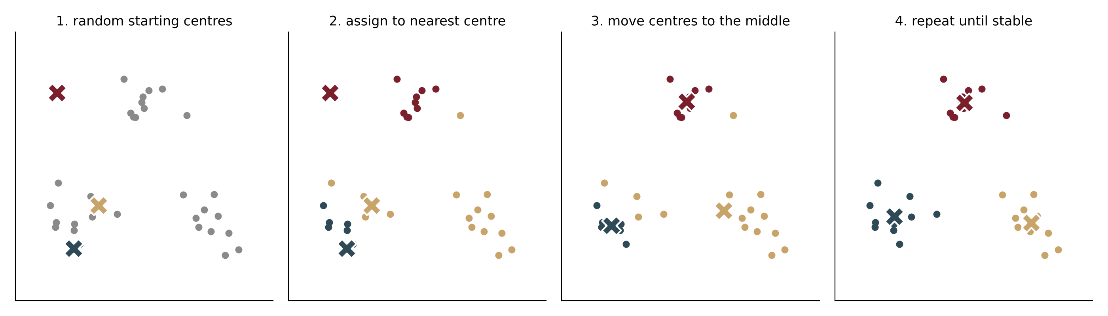
Clustering: grouping without labels
5 · CLASSIFICATION AND CLUSTERING
No labels this time: let the computer find groups of similar texts by itself (k-means).
Like sorting a pile of laundry
without being told the categories: similar things end up together.
Choose k
how many groups you want; try a few and see which make sense.
Next slide
the same method on real documents.
Notes:
Figure: real k-means iterations on synthetic 2-D points. Brown result real (Session 5 lab Part 6 method).

Slide 58
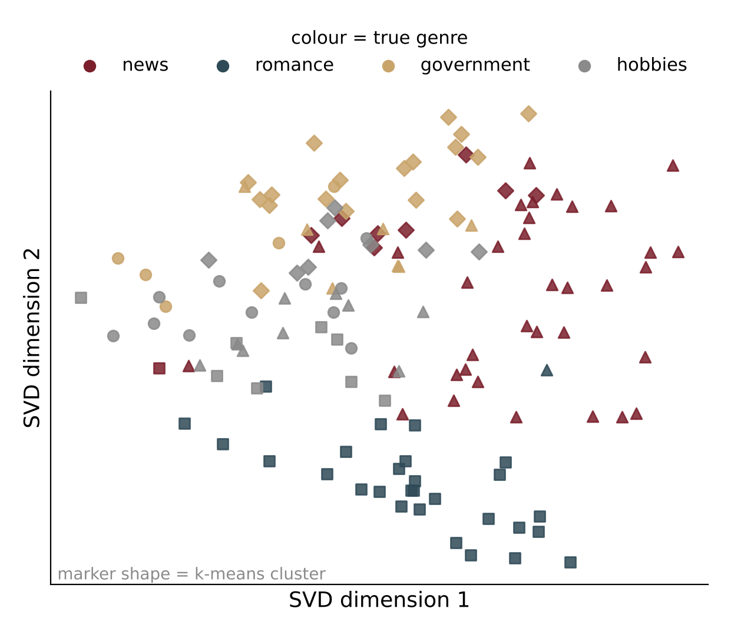
Clustering real documents
5 · CLASSIFICATION AND CLUSTERING
k-means on 139 real documents from four genres, without being told the genres.
GROUP FOUND | MOSTLY | TYPICAL WORDS
A | news | mr, president, state
B | romance | thought, eyes, didn
C | government | tax, development, sales
D | hobbies | inch, shelter, clay
It worked, mostly
two-thirds of documents landed in a group dominated by their own genre.
Mixed groups
hobbies and government overlap: both use practical, technical words.
Notes:
Real: Brown corpus categories news, romance, government, hobbies; TF-IDF; KMeans k = 4. Purity 0.66.

Slide 59

Support vector machines
6
Draw the widest possible street between two groups.

Slide 60
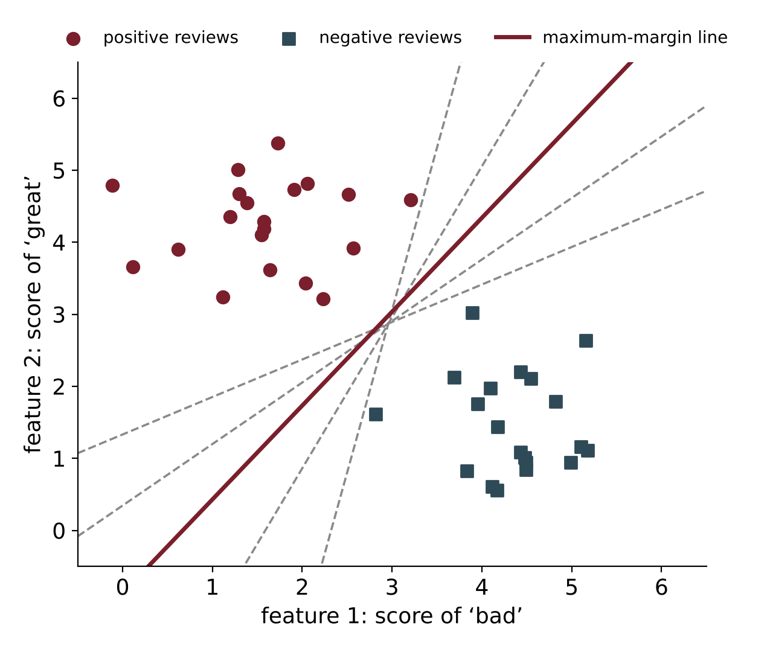
Reviews as points on a map
6 · SUPPORT VECTOR MACHINES
Give each review two numbers: how often it says “bad”, and how often “great”.
Each dot is a review
maroon = positive (high “great”), blue = negative (high “bad”).
Classifying
= drawing a line. New reviews on one side are positive, on the other negative.
Many lines work
all the grey lines separate the two groups perfectly. Which one should we trust?
Real text
has thousands of words, so thousands of axes. The idea is the same.
Notes:
Figure: real SVM on synthetic 2-D data.

Slide 61
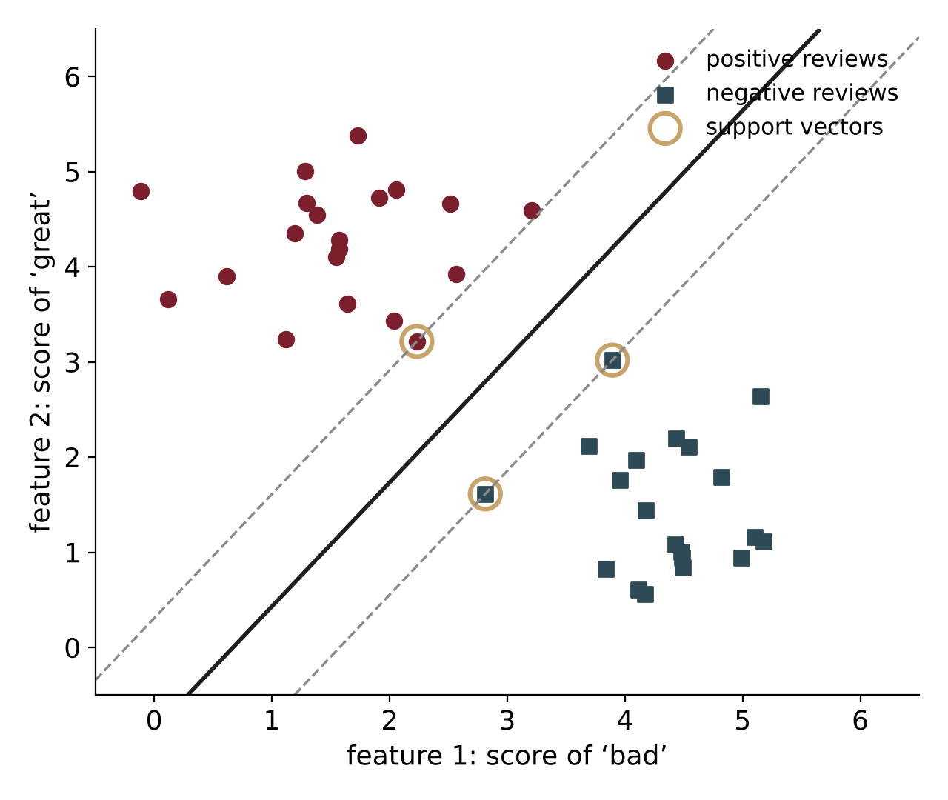

Pick the widest street
6 · SUPPORT VECTOR MACHINES
An SVM draws the line that leaves the widest empty street between the two groups.
Think of a road between two neighbourhoods: the wider the road, the less likely a new house ends up on the wrong side.
A narrow street
a tiny change in a new review could push it across the line: fragile.
A wide street
new reviews must be quite different to be misclassified: robust.
This is the SVM's one big idea
maximise the margin (the street's width).
Notes:
Figure: real linear SVM on 2-D toy data.

Slide 62
Support vectors: the reviews that matter
6 · SUPPORT VECTOR MACHINES
Only the reviews at the edge of the street decide where it goes.
Circled points
3 support vectors: they ‘support’ the edges of the street, like fence posts.
The rest don't matter
delete any review far from the street and the line stays exactly where it is.
Why it is useful
the model depends on a few important examples, not on every review.
Name
support vector machine = a machine defined by its support vectors.
Notes:
3 support vectors in the real fit shown.

Slide 63
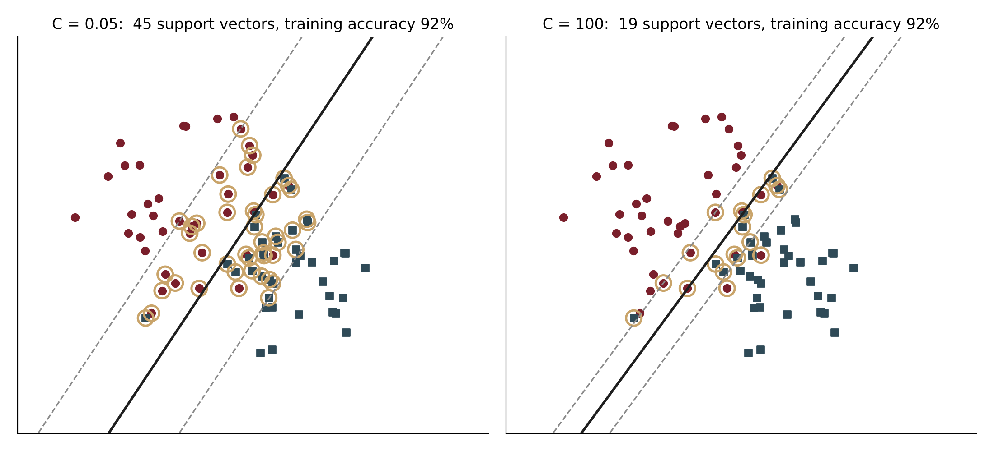
Real data is messy: allow a few mistakes
6 · SUPPORT VECTOR MACHINES
When groups overlap, a perfect street is impossible. Setting C decides how strict to be.
Small C (left)
relaxed: wide street, some reviews allowed inside it.
Large C (right)
strict: narrow street, tries hard to get every training review right.
Best
in between; we test a few values (slide 9).
Why reviews overlap. Sarcasm (“great, another two-hour queue”), mixed opinions, and mislabelled examples put some reviews on the ‘wrong’ side.
Notes:
Real: C = 0.05 gives 45 support vectors; C = 100 gives 19. Both reach 92.5% training accuracy.

Slide 64
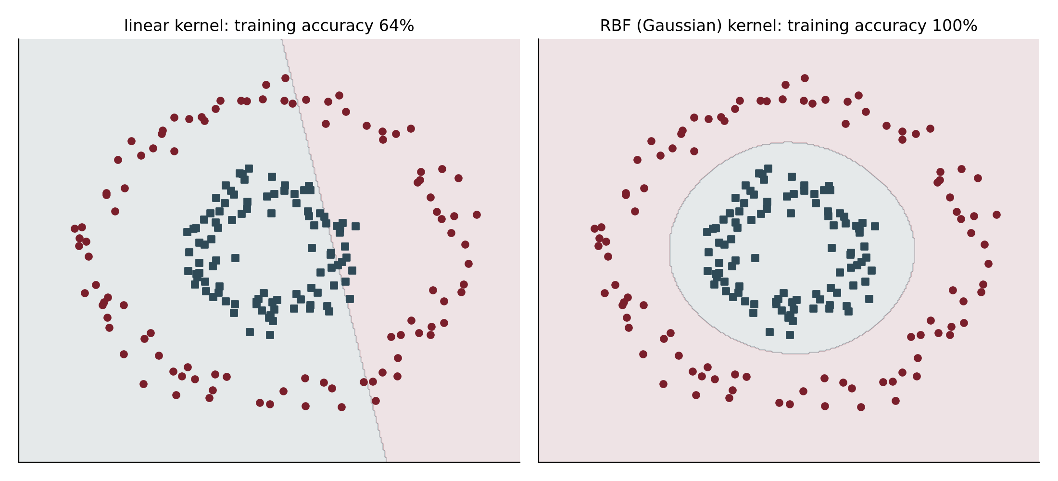
When a straight line can't work: the kernel trick
6 · SUPPORT VECTOR MACHINES
Some groups are arranged in circles. A kernel lets the SVM draw curved boundaries.
Straight line: 64%
no straight line can separate a ring from its centre.
Kernel: 100%
the curved boundary follows the ring.
The idea
imagine lifting the inner dots up off the page: then a flat sheet can separate them.
For text, usually not needed. With thousands of word-columns, a straight line (linear SVM) almost always works well, and it is much faster.
Notes:
Real: 200 points; linear kernel 63.5%, RBF kernel 100% training accuracy.

Slide 65
Why SVMs are good at text
6 · SUPPORT VECTOR MACHINES
Text has many words, few per document, and most words help a little. SVMs like that.
Thousands of columns
20,819 word columns for 1,500 training reviews: more columns than examples. The wide-street idea stops the model from memorising.
Mostly zeros
each review uses only a few hundred words; linear SVMs skip the zeros and train in a fraction of a second.
Every word helps a bit
the SVM gives every word a weight instead of choosing a few keywords.
Groups separate well
texts about different topics use different words, so a line separates them.
History. Joachims (1998) showed SVMs beat the other text classifiers of the time on news topics; they were the default for about ten years.
Notes:
Training time on the movie-review data: about 0.04 seconds (real).

Slide 66
What the SVM learned: words and their weights
6 · SUPPORT VECTOR MACHINES
The SVM gives each word a weight: negative words pull left, positive words pull right.
bad
great
worst
perfect
boring
hilarious
ridiculous
fun
mess
excellent
← towards negative
towards positive →
To classify a review. Add up the weights of its words. Total below zero → negative; above zero → positive. Real weights from 2,000 movie reviews.
Notes:
Real LinearSVC weights (C = 1) on TF-IDF features.

Slide 67
Choosing how strict to be: tuning C
6 · SUPPORT VECTOR MACHINES
Try several values of C and keep the one that does best on reviews it hasn't seen.
Sweet spot: C = 0.3
86% on new reviews.
Too strict (big C)
100% on training reviews but worse on new ones: memorising.
Too relaxed (tiny C)
82%: the street is so wide it ignores useful detail.
Notes:
Real. In practice choose C by cross-validation on training data only.

Slide 68
SVMs in practice
6 · SUPPORT VECTOR MACHINES
Four lines of Python, and top results on real news topics.
from sklearn.pipeline import make_pipeline
from sklearn.feature_extraction.text import TfidfVectorizer
from sklearn.svm import LinearSVC
model = make_pipeline(TfidfVectorizer(), LinearSVC())
model.fit(train_texts, train_labels)
model.predict(["Oil prices rose as OPEC cut output"])
Text → TF-IDF numbers → SVM → label
More than two groups? Train one SVM per topic (“oil vs everything else”, “trade vs everything else” …) and pick the topic whose SVM is most confident.
Notes:
Real Reuters-21578 results (NLTK, single-topic stories). One-vs-rest is LinearSVC's default.

Slide 69
SVM: summary
6 · SUPPORT VECTOR MACHINES
Widest street, a few support vectors, word weights you can read.
GOOD AT | WATCH OUT FOR
very accurate on text (84% reviews, 97% news topics) | C must be tuned
handles thousands of words easily | gives a decision, not a probability (extra step needed)
fast to train with a linear kernel | curved kernels are slow on big datasets
same result every time you train | still ignores word order: “not good” ≈ “good not”
When to choose an SVM. Topic or sentiment classification with a few thousand labelled texts: an SVM on TF-IDF is a reliable first choice.
Notes:
Results quoted are real (Topics 5 and 6).

Slide 70

Centroid-based classification
7
Compare a new text with the ‘average’ text of each group.

Slide 71
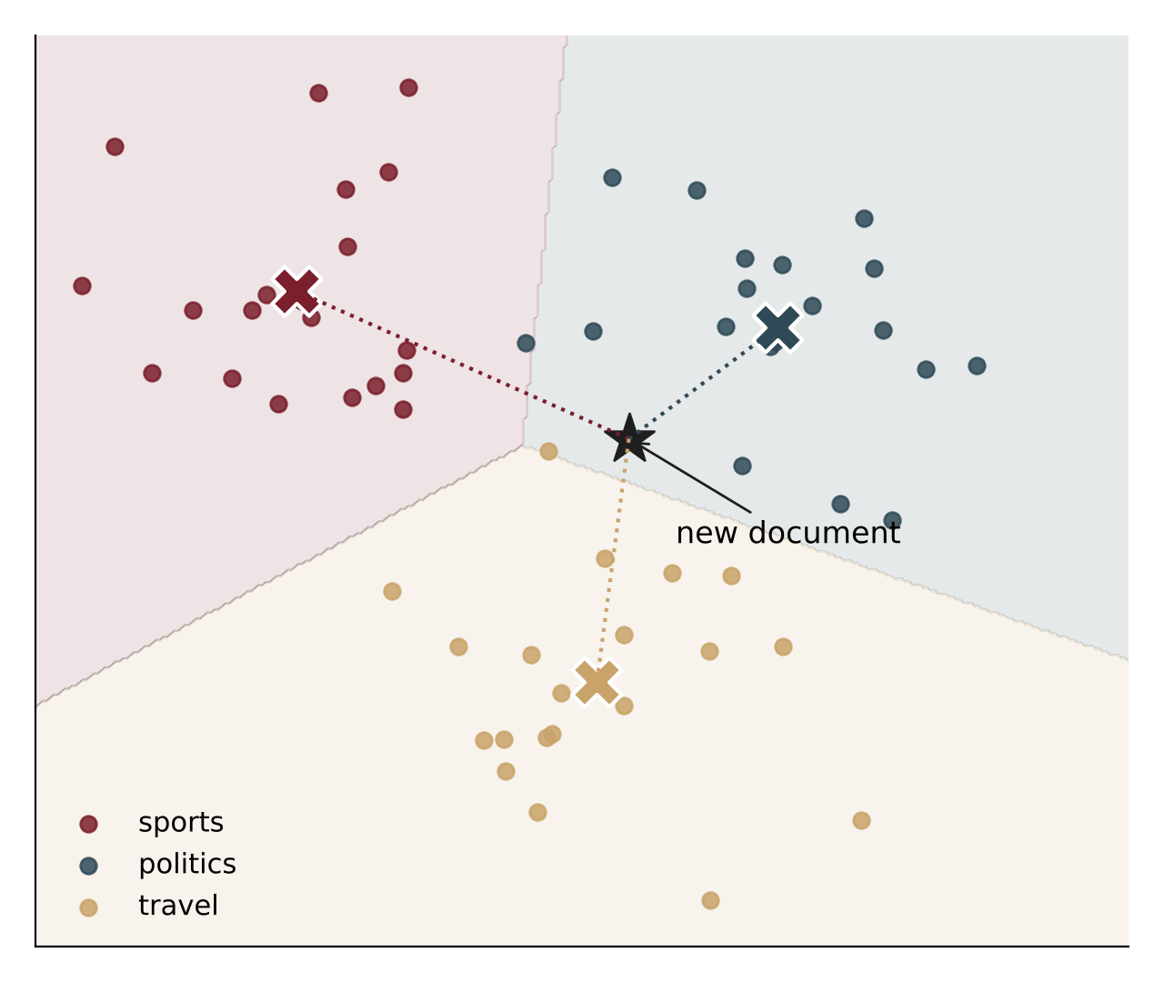
The idea: the ‘average member’ of each group
7 · CENTROID-BASED CLASSIFICATION
Make one average review per class. A new review joins the class whose average it is closest to.
Centroid
= the centre point of a group, marked ✕. Think of it as the ‘typical’ sports, politics or travel article.
New document ★
measure the distance to each ✕: 2.41, 1.28, 1.88.
Decision
closest is politics (1.28), so it is labelled politics.
Everyday analogy
a new student joins the house team whose average skills are most like theirs.
Notes:
Distances are real outputs of the plotting script (scikit-learn NearestCentroid).

Slide 72
Computing an average: first with numbers
7 · CENTROID-BASED CLASSIFICATION
A centroid is just an average, done separately for each column.
STUDENT | MATHS | ENGLISH
Asha | 80 | 60
Ravi | 70 | 70
Meera | 90 | 50
average (centroid) | 80 | 60
Column by column
maths: (80 + 70 + 90) ÷ 3 = 80; English: (60 + 70 + 50) ÷ 3 = 60.
The centroid
(80, 60): the ‘typical’ student of this group, even though no one scored exactly that.
Illustrative marks.
For text
columns are words; values are word counts or TF-IDF weights (next slide).
Notes:
Plain averages to build intuition before word vectors.

Slide 73
Centroids for reviews
7 · CENTROID-BASED CLASSIFICATION
Average the word columns of the positive reviews, then of the negative reviews.
REVIEW (ILLUSTRATIVE) | CLASS | great | magical | queue | rude
great day, magical show | pos | 1 | 1 | 0 | 0
great rides, short queue | pos | 1 | 0 | 1 | 0
great and magical | pos | 1 | 1 | 0 | 0
rude staff, long queue | neg | 0 | 0 | 1 | 1
great food, rude staff, queue | neg | 1 | 0 | 1 | 1
the queue never moved | neg | 0 | 0 | 1 | 0
positive centroid |  | 1.00 | 0.67 | 0.33 | 0
negative centroid |  | 0.33 | 0 | 1.00 | 0.67
1 = word present
0 = absent.
Reading it
a typical positive review always says “great”, often “magical”. A typical negative one always mentions the “queue”, often “rude”.
Training = averaging
the fastest classifier to train.
Notes:
Illustrative reviews; centroid arithmetic exact (e.g. magical: (1 + 0 + 1) ÷ 3 = 0.67).

Slide 74
Classifying a new review
7 · CENTROID-BASED CLASSIFICATION
New: “great day, but the queue and the rude staff ruined it” → great 1, magical 0, queue 1, rude 1.
 | great | magical | queue | rude | MATCH SCORE
new review | 1 | 0 | 1 | 1
× positive centroid | 1.00 | 0.67 | 0.33 | 0 | 1 + 0 + 0.33 + 0 = 1.33
× negative centroid | 0.33 | 0 | 1.00 | 0.67 | 0.33 + 0 + 1 + 0.67 = 2.00
Decision: negative (match 2.00 vs 1.33). After adjusting for length (cosine): 0.93 vs 0.62. Same answer.
Match score
multiply word by word and add up: big when the review uses the words that are typical of the class.
Fast
only one comparison per class, however many training reviews there were.
Notes:
The match score is the dot product; cosine divides by the lengths (√3 × 1.25). Computed exactly.

Slide 75
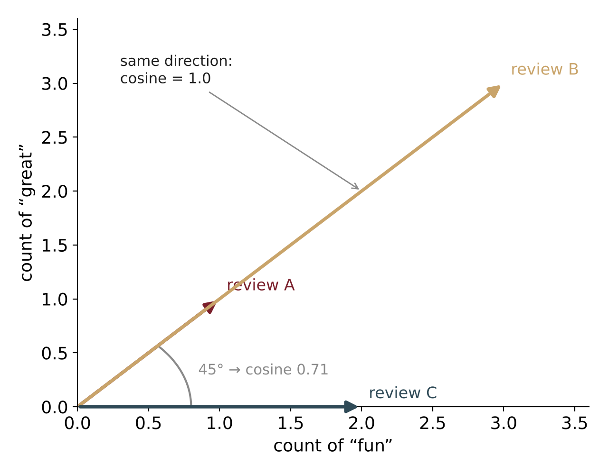
Closeness by direction, not length
7 · CENTROID-BASED CLASSIFICATION
A long review saying “fun, great” three times should match a short one saying it once.
Each review is an arrow
pointing in the direction of the words it uses.
A and B
same words in the same proportions → same direction → cosine = 1 (a perfect match), although B is three times longer.
A and C
C only says “fun” → 45° apart → cosine 0.71.
Cosine similarity
1 = same direction, 0 = no words in common. The standard way to compare documents.
Notes:
cos 45° = 0.71.

Slide 76
From search engines to classifiers: Rocchio
7 · CENTROID-BASED CLASSIFICATION
The same idea first improved search results, in the 1970s.
In search (relevance feedback)
You mark some results as useful and some as useless. The engine moves your query towards the average of the useful ones and away from the useless ones, then searches again.
In classification
Each class gets one prototype: the average of its documents (optionally pushed away from other classes). A new document gets the label of the most similar prototype.
Name. After J. J. Rocchio (1971). In text classification, ‘Rocchio classifier’, ‘centroid classifier’ and ‘nearest-centroid’ mean nearly the same thing.
Notes:
Rocchio, J. J. (1971), Relevance feedback in information retrieval (SMART system).

Slide 77
Real results
7 · CENTROID-BASED CLASSIFICATION
Simple averaging comes surprisingly close to the best methods.
WHAT THE REAL CENTROIDS CONTAIN
crude oil: oil, crude, prices, opec, barrels
interest: rate, pct, bank, prime, rates
trade: trade, japan, billion, deficit
positive review: life, great, perfect, excellent
negative review: bad, worst, boring, stupid
Notes:
Real: NearestCentroid on TF-IDF. Word lists are the highest-weight terms in each Reuters centroid and the largest positive/negative centroid differences for movie reviews.

Slide 78
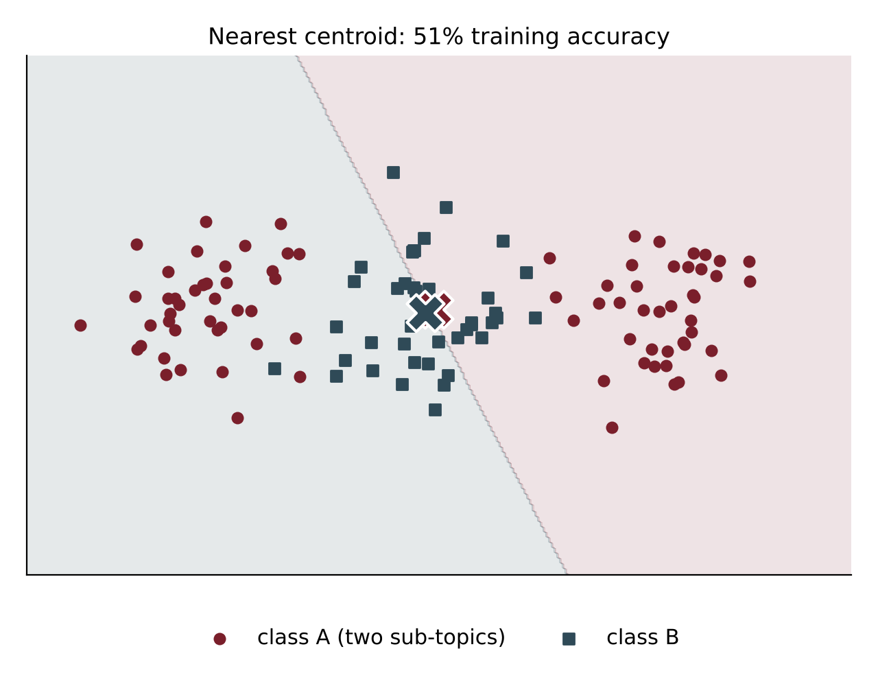
When averaging fails
7 · CENTROID-BASED CLASSIFICATION
If a class contains two different kinds of things, its ‘average’ may look like neither.
The picture
class A (maroon) has two clusters, left and right. Its average ✕ lands in the middle, right where class B (blue) lives.
Real result
the centroid method gets only 51% right (coin-flip level). Asking the 5 nearest neighbours gets 98%.
In text
a ‘sports’ class mixing cricket and chess, or ‘complaints’ about food and about queues, may not have one typical review.
Fix
use several centroids per class, or k-NN, or an SVM.
Notes:
Real: synthetic 2-D data, scikit-learn NearestCentroid vs KNeighborsClassifier(5).

Slide 79
Building a centroid classifier: three steps
7 · CENTROID-BASED CLASSIFICATION
Average, compare, choose. That's the whole algorithm.
1 Average
2 Compare
3 Choose
for each class, average the TF-IDF vectors of its training documents.
for a new document, compute its similarity (cosine) with every class average.
give it the label of the most similar class average.
from sklearn.pipeline import make_pipeline
from sklearn.feature_extraction.text import TfidfVectorizer
from sklearn.neighbors import NearestCentroid
model = make_pipeline(TfidfVectorizer(), NearestCentroid())
model.fit(train_texts, train_labels)
Adding a new class
just average its examples: no retraining of the others.
Many classes
works even with hundreds of categories.
Notes:
NearestCentroid uses Euclidean distance; on length-normalised TF-IDF vectors this ranks classes almost exactly as cosine does.

Slide 80
Centroid vs k-NN vs SVM: which to use?
7 · CENTROID-BASED CLASSIFICATION
Three ways to classify, from simplest to strongest.
 | CENTROID | k-NN | SVM
The idea | compare with each class's average | ask the most similar examples | widest street between classes
Training | just averaging: instant | none: store everything | an optimisation: fast for text
Predicting | fast: one comparison per class | slow: compare with every example | fast: add up word weights
Easy to explain? | yes: “closest to the typical X” | yes: “similar to these reviews” | partly: word weights
Real: movie reviews | 81% | 76% | 84%
Real: Reuters news | 92% | 95% | 97%
Rule of thumb. Start with a centroid or Naive Bayes as a quick baseline; use an SVM or logistic regression when accuracy matters.
Notes:
All accuracies real, rounded.

Slide 81
The whole session in seven sentences
SUMMARY
1
Probability count how often something happens and divide by the total.
2
Discrete-time models text is a chain; each word depends mostly on the one before.
3
Markov and entropy models predict next words, smooth away zeros, find hidden tags with Viterbi, measure surprise.
4
Statistical parsing of all possible sentence structures, choose the one with the highest probability.
5
Classification and clustering turn text into word numbers; sort with labels, or group without them.
6
SVM draw the widest possible street between the classes.
7
Centroids compare a new text with the average text of each class.
Notes:
Use with the Session 5 lab notebook.

Slide 82
Try these with pencil and paper
SELF-CHECK
1
Using our 8 reviews: what is P(“was”)?
2
What is P(positive | “rude”)?
3
Using the transition table: P(“the staff were rude”)?
4
Why does “the park was magical” get probability 0, and how does add-one fix it?
5
Weather chain: today Rainy. P(Rainy tomorrow and Sunny the day after)?
6
Which tree wins for the telescope sentence, and why?
7
Naive Bayes: classify “staff were cold” using our 8 reviews.
8
Why can averaging fail for a class with two sub-topics?
Notes:
Answers: (1) 0.125; (2) 0 — 'rude' only appears in a negative review; (3) 1 × 2/8 × 1 × 1/4 = 0.0625; (4) 'was magical' never occurs; add-one gives every pair a small count; (5) 0.6 × 0.4 = 0.24; (6) verb attachment, because VP → VP PP (0.3) beats NP → NP PP (0.2); (7) positive (1+1)(2+1)(0+1) = 6, negative (1+1)(2+1)(1+1) = 12 → negative; (8) the average falls between the sub-topics, possibly inside another class.

